Slide 1
Report batch 20230412_Parylene

Slide 2
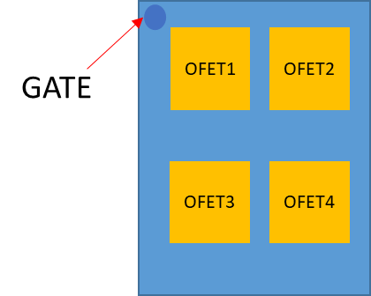
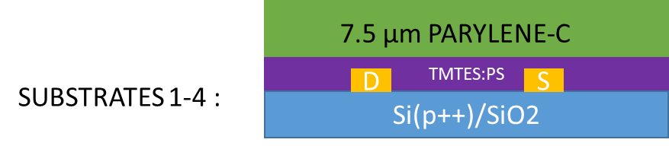
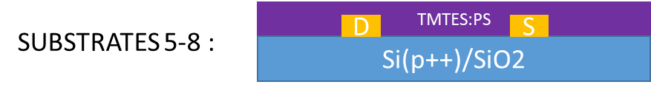

General features
Batch made up of 8 substrates, each one of them containing 4 OFETs with common gate
The first 4 substrates are coated by Parylene-C, an electrically insulating polymer
TMTES:PS as active material, with fixed 2:1 ratio and 280K molecular weight
Channel features: L=25µm, W=2500µm, C=17.3·${10}^{−9}$F/${cm}^{2},$
$A_{pixel}={4.25·10}^{−3}{cm}^{2}$

Slide 3
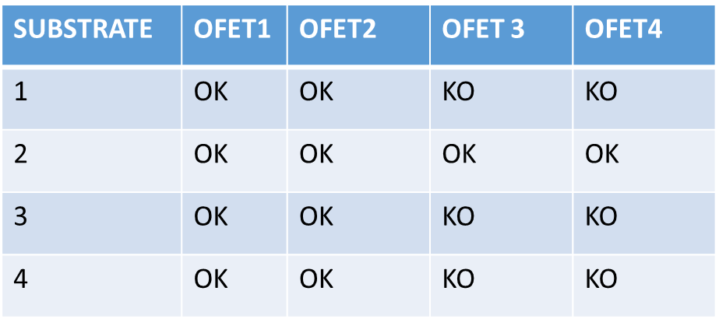
Parylene samples: working devices

Slide 4
X-rays measurements: Current normalization
Polynomial fit before irradiation

Slide 5
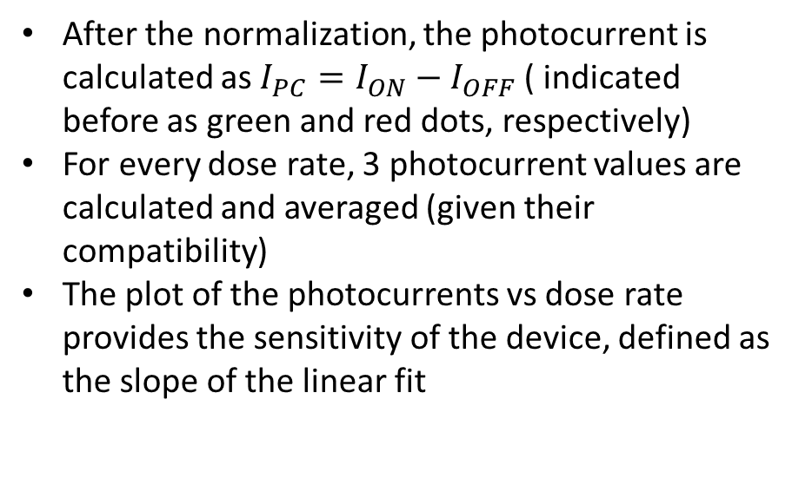
X-rays measurements: sensitivity calculation
After the normalization, the photocurrent is calculated as ${I_{PC}=I}_{ON}−I_{OFF}$ ( indicated before as green and red dots, respectively)
For every dose rate, 3 photocurrent values are calculated and averaged (given their compatibility)
The plot of the photocurrents vs dose rate provides the sensitivity of the device, defined as the slope of the linear fit

Slide 6
Parylene samples

Slide 7

Parylene samples
Transfer characteristics
Output characteristic (example)
:Working point ($V_{SG}=−2.5V, V_{SD}=−10V$)

Slide 8
Parylene: Current curves

Slide 9
Parylene: Photocurrent

Slide 10
Parylene: Transfer characteristic

Slide 11
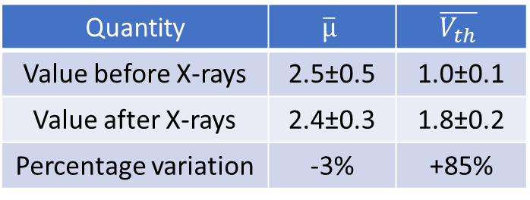
Parylene: Transfer before and after X-rays
Quantity | $$\overline{µ}$$ | $$\overline{V_{th}}$$
Value before X-rays | 2.5±0.5 | 1.0±0.1
Value after X-rays | 2.4±0.3 | 1.8±0.2
Percentage variation | -3% | +85%

Slide 12
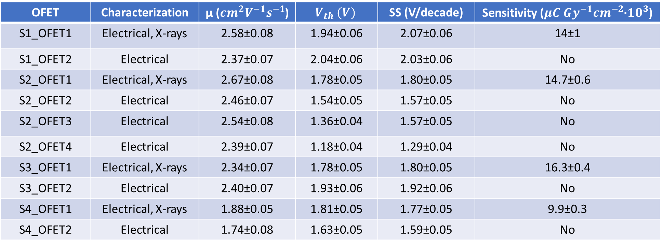
Summary table: Parylene
OFET | Characterization | µ (${cm}^{2}V^{−1}s^{−1}$) | $$V_{th} (V)$$ | SS (V/decade) | Sensitivity (${{μC Gy}^{−1}cm}^{−2}$·${10}^{3}$)
S1_OFET1 | Electrical, X-rays | 2.58±0.08 | 1.94±0.06 | 2.07±0.06 | 14±1
S1_OFET2 | Electrical | 2.37±0.07 | 2.04±0.06 | 2.03±0.06 | No
S2_OFET1 | Electrical, X-rays | 2.67±0.08 | 1.78±0.05 | 1.80±0.05 | 14.7±0.6
S2_OFET2 | Electrical | 2.46±0.07 | 1.54±0.05 | 1.57±0.05 | No
S2_OFET3 | Electrical | 2.54±0.08 | 1.36±0.04 | 1.57±0.05 | No
S2_OFET4 | Electrical | 2.39±0.07 | 1.18±0.04 | 1.29±0.04 | No
S3_OFET1 | Electrical, X-rays | 2.34±0.07 | 1.78±0.05 | 1.80±0.05 | 16.3±0.4
S3_OFET2 | Electrical | 2.40±0.07 | 1.93±0.06 | 1.92±0.06 | No
S4_OFET1 | Electrical, X-rays | 1.88±0.05 | 1.81±0.05 | 1.77±0.05 | 9.9±0.3
S4_OFET2 | Electrical | 1.74±0.08 | 1.63±0.05 | 1.59±0.05 | No
$\overline{µ}=(\text{2.3}\text{±}0.3){cm}^{2}V^{−1}s^{−1}, \overline{V_{th}}=\left(1.\text{7}\text{±}0.3\right) V, \overline{SS}=\left(1.7\text{±}0.2\right)V/decade$, $\overline{S}=(13.7±1.8)µC{Gy}^{−1}{cm}^{−2}{•10}^{3}$

Slide 13
No parylene samples (common features)

Slide 14

No parylene samples
Transfer characteristics*
Output characteristic (example)
*OFET3 and 4 of every sample are not shown to improve clarity
:Working point ($V_{SG}=−2.5V, V_{SD}=−10V$)

Slide 15
No parylene: Transfer characteristic

Slide 16
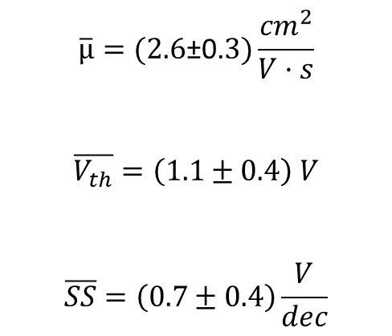
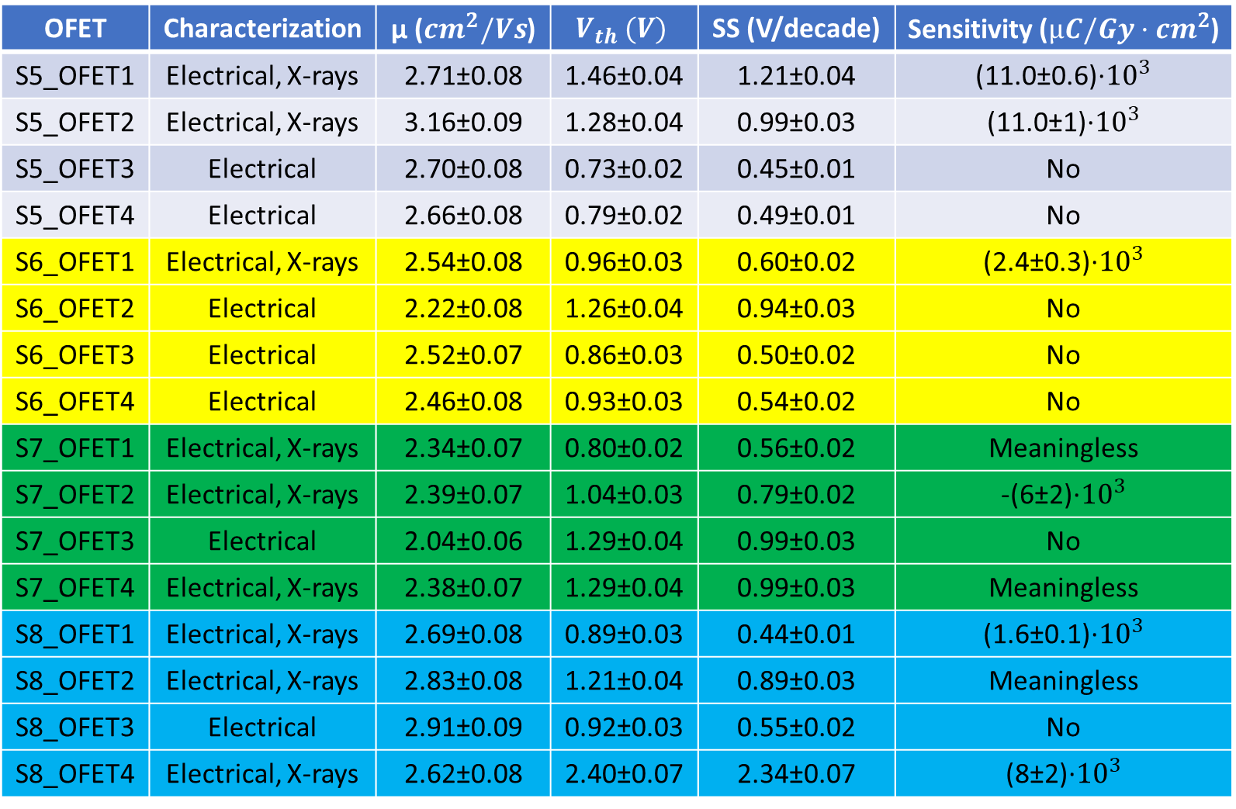
Summary table: No parylene
OFET | Characterization | µ (${cm}^{2}/Vs$) | $$V_{th} (V)$$ | SS (V/decade) | Sensitivity (${µC/Gy·cm}^{2}$)
S5_OFET1 | Electrical, X-rays | 2.71±0.08 | 1.46±0.04 | 1.21±0.04 | (11.0±0.6)·${10}^{3}$
S5_OFET2 | Electrical, X-rays | 3.16±0.09 | 1.28±0.04 | 0.99±0.03 | (11.0±1)·${10}^{3}$
S5_OFET3 | Electrical | 2.70±0.08 | 0.73±0.02 | 0.45±0.01 | No
S5_OFET4 | Electrical | 2.66±0.08 | 0.79±0.02 | 0.49±0.01 | No
S6_OFET1 | Electrical, X-rays | 2.54±0.08 | 0.96±0.03 | 0.60±0.02 | (2.4±0.3)·${10}^{3}$
S6_OFET2 | Electrical | 2.22±0.08 | 1.26±0.04 | 0.94±0.03 | No
S6_OFET3 | Electrical | 2.52±0.07 | 0.86±0.03 | 0.50±0.02 | No
S6_OFET4 | Electrical | 2.46±0.08 | 0.93±0.03 | 0.54±0.02 | No
S7_OFET1 | Electrical, X-rays | 2.34±0.07 | 0.80±0.02 | 0.56±0.02 | Meaningless
S7_OFET2 | Electrical, X-rays | 2.39±0.07 | 1.04±0.03 | 0.79±0.02 | -(6±2)·${10}^{3}$
S7_OFET3 | Electrical | 2.04±0.06 | 1.29±0.04 | 0.99±0.03 | No
S7_OFET4 | Electrical, X-rays | 2.38±0.07 | 1.29±0.04 | 0.99±0.03 | Meaningless
S8_OFET1 | Electrical, X-rays | 2.69±0.08 | 0.89±0.03 | 0.44±0.01 | (1.6±0.1)·${10}^{3}$
S8_OFET2 | Electrical, X-rays | 2.83±0.08 | 1.21±0.04 | 0.89±0.03 | Meaningless
S8_OFET3 | Electrical | 2.91±0.09 | 0.92±0.03 | 0.55±0.02 | No
S8_OFET4 | Electrical, X-rays | 2.62±0.08 | 2.40±0.07 | 2.34±0.07 | (8±2)·${10}^{3}$
$$\overline{µ}=\text{(2.6}\text{±}\text{0.}3)\frac{{cm}^{2}}{V·s}$$
$$\overline{V_{th}}=\left(1.1±0.4\right) V$$
$$\overline{SS}=\left(0.7±0.4\right)\frac{V}{dec}$$

Slide 17
Sample5: Current curves

Slide 18
Sample5: Photocurrent

Slide 19
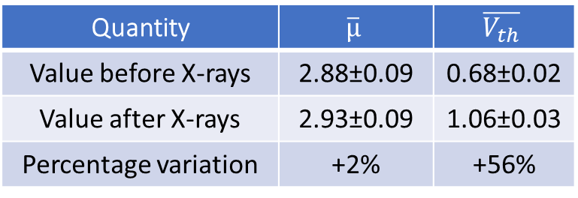
Sample5: Transfer before and after X-rays
Quantity | $$\overline{µ}$$ | $$\overline{V_{th}}$$
Value before X-rays | 2.88±0.09 | 0.68±0.02
Value after X-rays | 2.93±0.09 | 1.06±0.03
Percentage variation | +2% | +56%

Slide 20
Sample6: Current curves

Slide 21
Sample6: Photocurrent

Slide 22
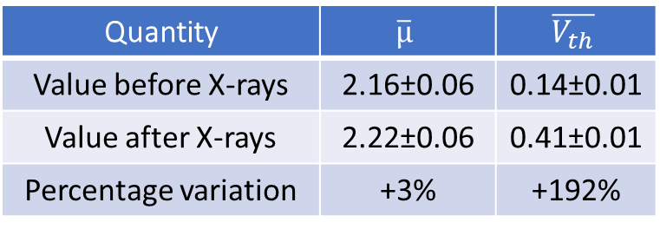
Sample6: Transfer before and after X-rays
Quantity | $$\overline{µ}$$ | $$\overline{V_{th}}$$
Value before X-rays | 2.16±0.06 | 0.14±0.01
Value after X-rays | 2.22±0.06 | 0.41±0.01
Percentage variation | +3% | +192%

Slide 23
Sample7: Current curves

Slide 24
Sample7: Photocurrent

Slide 25
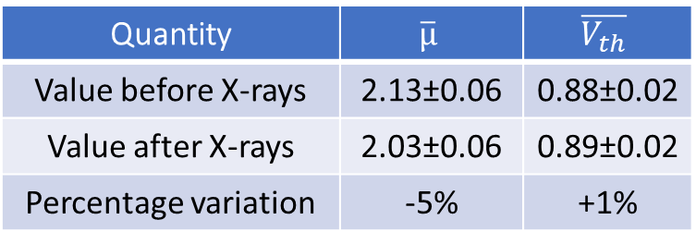
Sample7: Transfer before and after X-rays
Quantity | $$\overline{µ}$$ | $$\overline{V_{th}}$$
Value before X-rays | 2.13±0.06 | 0.88±0.02
Value after X-rays | 2.03±0.06 | 0.89±0.02
Percentage variation | -5% | +1%

Slide 26
Sample8: Current curves

Slide 27
Sample8: Photocurrent

Slide 28
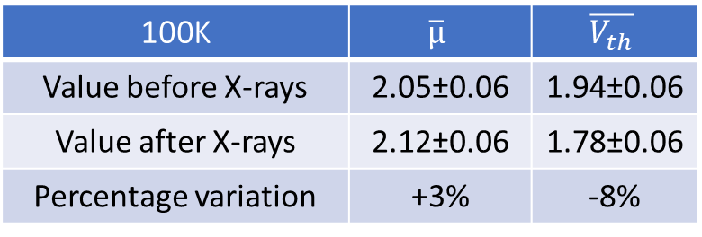
Sample8: Transfer before and after X-rays
100K | $$\overline{µ}$$ | $$\overline{V_{th}}$$
Value before X-rays | 2.05±0.06 | 1.94±0.06
Value after X-rays | 2.12±0.06 | 1.78±0.06
Percentage variation | +3% | -8%

Slide 29
Composition comparisons

Slide 30
Transfer characteristic
The leakage current is remarkably high in samples coated with parylene
Parylene samples have a slightly worse shape of the transfer characteristic
Parylene samples electrical parameters have less fluctuations (see next slides)

Slide 31
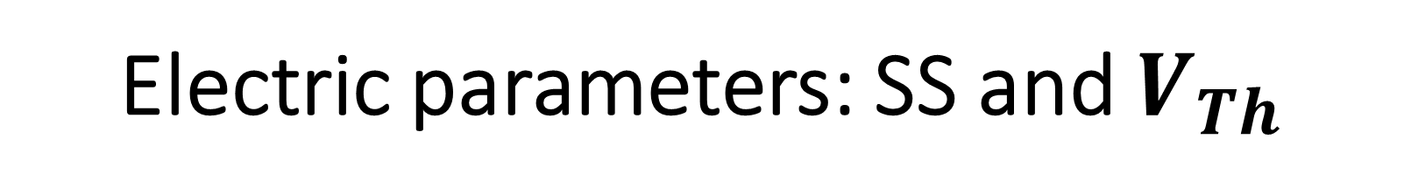
Electric parameters: SS and $V_{Th}$

Slide 32
Electric parameters: Mobility

Slide 33
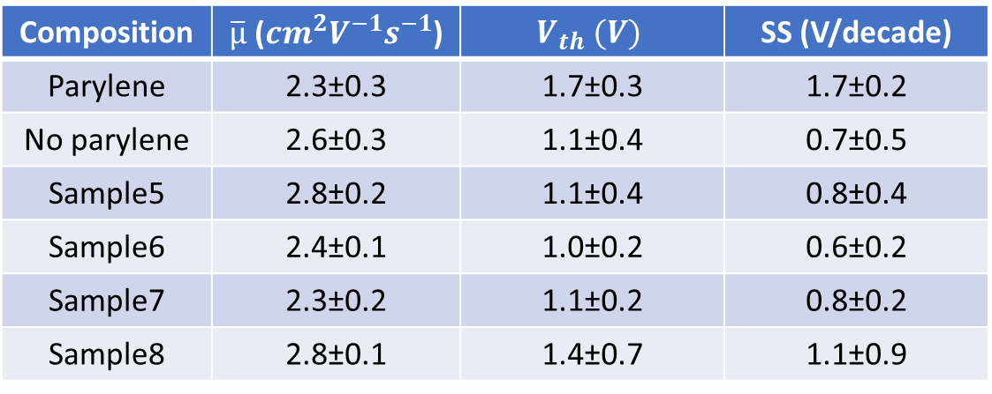
Electric parameters:
Composition | $\overline{µ}$ (${cm}^{2}V^{−1}s^{−1}$) | $$V_{th} (V)$$ | SS (V/decade)
Parylene | 2.3±0.3 | 1.7±0.3 | 1.7±0.2
No parylene | 2.6±0.3 | 1.1±0.4 | 0.7±0.5
Sample5 | 2.8±0.2 | 1.1±0.4 | 0.8±0.4
Sample6 | 2.4±0.1 | 1.0±0.2 | 0.6±0.2
Sample7 | 2.3±0.2 | 1.1±0.2 | 0.8±0.2
Sample8 | 2.8±0.1 | 1.4±0.7 | 1.1±0.9
Parylene samples have worse electrical parameters
On the other hand, their electrical parameters have smaller standard deviations

Slide 34
X-rays detection: currents in time

Slide 35
X-rays detection: currents in time
Parylene samples and Sample5 have similar current trends
Sample6 and Sample7 have an initial current drop, followed by a recover
Sample8 is different from all the others, and is quite similar to batch0315
This last sample is the only one following the behaviour that we would expect, since sample without parylene are identical (in composition) to batch0315

Slide 36
X-rays detection: normalized currents

Slide 37
X-rays detection: normalized currents
Parylene samples and Sample5 have similar photocurrent trends, with a triangular shape and a very good homogeneity
Sample6 photocurrent is influenced by the initial current drop
Sample7 photocurrents are always negative
Sample8 photocurrent is different from all the others, but is quite different from the batch0315 ones, due to the presence of smooth peaks

Slide 38
Sensitivity comparison

Slide 39
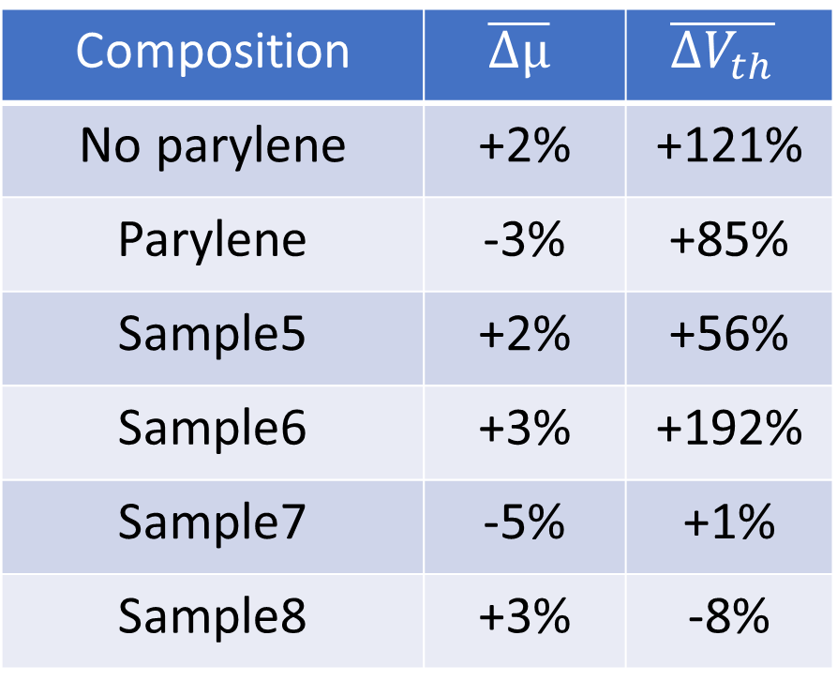
Resume on electical parameters variation after X-rays irradiation
Composition | $$\overline{Δµ}$$ | $$\overline{{ΔV}_{th}}$$
No parylene | +2% | +121%
Parylene | -3% | +85%
Sample5 | +2% | +56%
Sample6 | +3% | +192%
Sample7 | -5% | +1%
Sample8 | +3% | -8%
Mobilities tend to remain stable after irradiation in all samples
Samples without parylene have no common behaviour when it comes to threshold voltage
Sample5 and Sample6 have important increases in the threshold voltage, while Sample7 and Sample8 retain their transfer curves after the irradiation

Slide 40
Conclusions
Samples with parylene show a «triangle-like» photocurrent that is present with very small deviations in all the samples
Sample5 is very similar to parylene samples under every aspect, although no clear reason for this has been found
Samples without parylene appear to be very different from each other
Even if the composition is the same of batch0315, they look very different in current shapes (Sample8 is the more similar to batch0315)
Sample7 show negative photocurrents

